Slide 1



UNIT 1
LESSON 4
HARD TO BELIEVE
Part 3

Slide 2
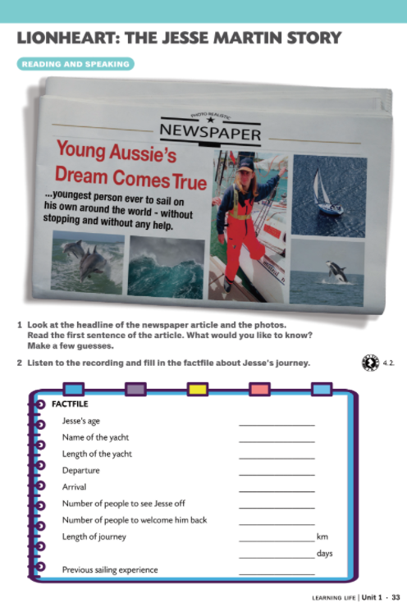
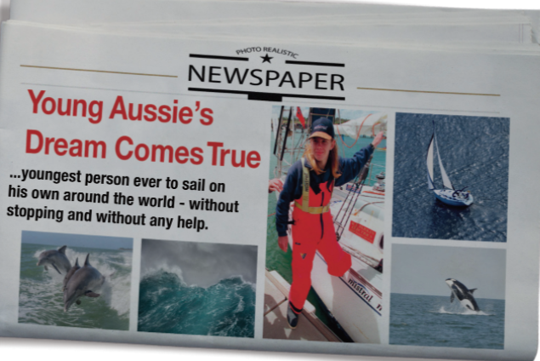

Slide 3
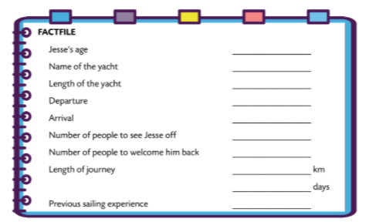

17
Lionheart
11 m
December 7, 1998
October 31, 1999
300
20 000
50 000
and 328
3 hours

Slide 4
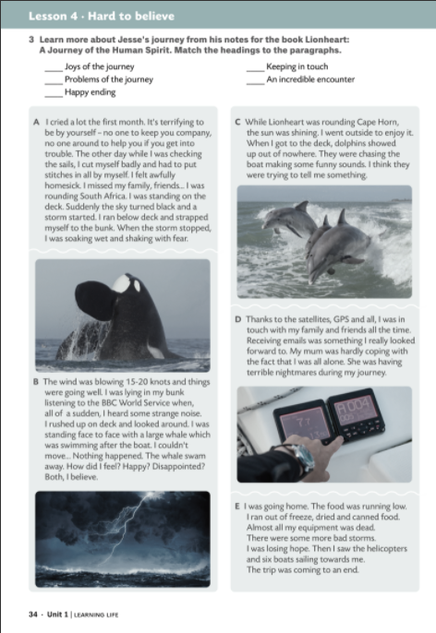
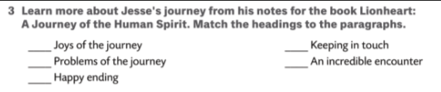
What problems did he have?
Did he keep in touch with his family?
How did he do that?
Did he meet anyone or anything on his trip?
Did he have any interesting encounters?
Did he enjoy his journey?
How did the journey end?
Was it a happy ending?
Na koje probleme je naišao?
Je li ostao u kontaktu sa svojom obitelji?
Kako je to izveo?
Je li na tom putovanju susreo ikoga ili išta?
Je li imao zanimljive susrete?
Je li na putovanju uživao?
Kako je putovanje završilo?
Ima li putovanje sretan završetak?

Slide 5
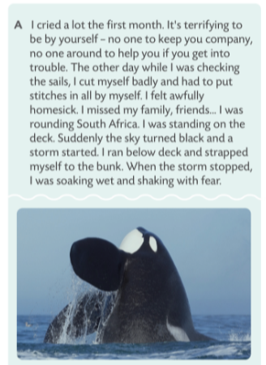
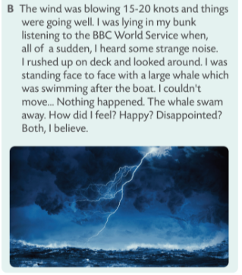
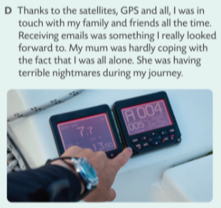
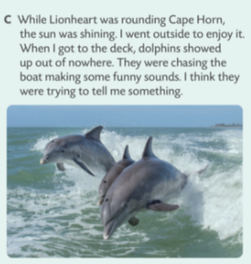
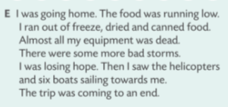
C
D
A
B
E

Slide 6

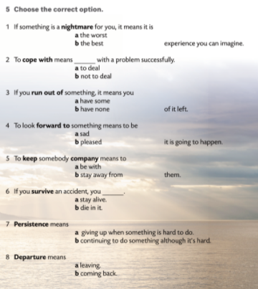
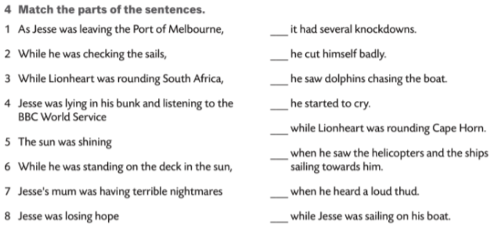








3
2
6
1
5
8
4
7

